Slide 1

CSE- 321
Software Engineering
Lecture : 02 Introduction (Cont.)
Fahad Ahmed
Lecturer, Dept. of CSE
E-mail: fahadahmed@uap-bd.edu

Slide 2
Lecture Outlines
Classification of Software
What is Software Engineering?
Importance of Software Engineering
Program vs Software Product
Software Engineering vs System Engineering
Software Process
Software Process Model
Key Challenges Facing Software Engineering
Software Engineering Ethics

Slide 3
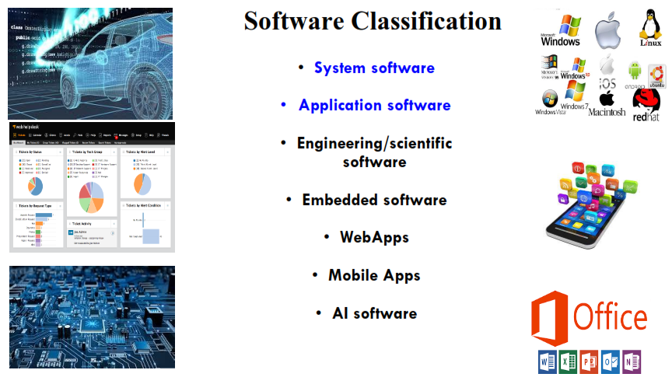
Classification of Software

Slide 4
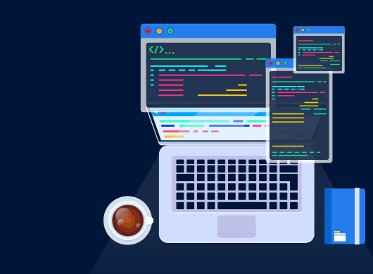
Software Engineering
Then,
what is Software
Engineering ?

Slide 5
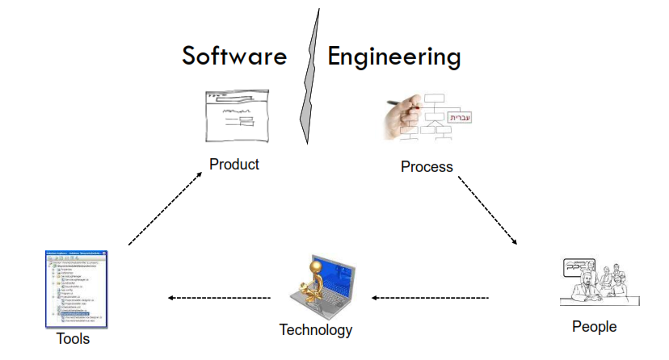
Software Engineering

Slide 6
Software Engineering
What is software engineering?
Software engineering is an engineering discipline that is concerned with all aspects of software production from the early stages of system specification through to maintaining the system after it has gone into use.
Software engineering is an engineering discipline whose focus is the cost effective development of the high quality software system.
IEEE, in its standard 610.12-1990, defines software engineering as the application of a systematic, disciplined, which is a computable approach for the development, operation, and maintenance of software.

Slide 7
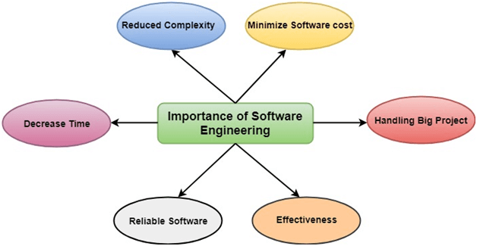
Importance of Software Engineering

Slide 8
Program vs Software Product
Program is a set of instruction related each other where as Software Product is a collection of program designed for specific task.
Programs are developed by individuals that means single user where as Software Product are developed by large no of users.
In program, there is no documentation or lack in proper documentation. In Software Product, Proper documentation and well documented and user manual prepared.
Development of program is Unplanned, not Systematic etc. but Development of Software Product is well Systematic, organized, planned approach.
Programs provide Limited functionality and less features where as Software Products provides more functionality as they are big in size (lines of codes) more options and features.

Slide 9
Software Engineering and System Engineering
What is the difference between software engineering and system engineering?
System engineering is concerned with all aspects of computer-based systems development including hardware, software and process engineering.
Software engineering is part of this more general process.
System engineers are involved in (overall) system specification, architectural design, integration, and deployment

Slide 10
Software process
What is a software process?
A software process is a sequence of activities that leads to the production of a software product.
Generic activities in all software processes are:
Software Specification
Software Development
Software Validation
Software Evolution

Slide 11
General issues that affect software
General issues that affect software
Heterogeneity
Business and social change
Security and trust
Scale

Slide 12
Software Process Model
What is a software process model?
A software process model is a simplified description of a software process that presents one view of that process. Process models may include activities that are part of the software process, software products and the roles of people involved in software engineering.
Examples of process perspectives are:
Workflow perspective - sequence of activities, UML Sequence Diagrams
Data-flow perspective - information flow, DFD’s
Role/action perspective - who does what. Gantt Charts
Most software process models are based on one of three general models or paradigms of software development:
The waterfall approach
Iterative development
Component-based software engineering (CBSE)

Slide 13
Key challenges facing software engineering
What are the key challenges facing software engineering?
Coping with legacy systems, coping with increasing diversity and coping with demands for reduced delivery times.
Legacy systems – old, valuable systems must be maintained and updated.
Heterogeneity – systems are distributed and include a mix of hardware and software.
Delivery – there is increasing pressure for faster delivery of software.

Slide 14
Internet Software Engineering
The Web is now a platform for running application and organizations are increasingly developing web-based systems rather than local systems.
Web services allow application functionality to be accessed over the web.
Cloud computing is an approach to the provision of computer services where applications run remotely on the ‘cloud’.
Users do not buy software buy pay according to use.

Slide 15
Software engineering ethics
Software engineering involves wider responsibilities than simply the application of technical skills.
Software engineers must behave in an honest and ethically responsible way if they are to be respected as professionals.
Ethical behaviour is more than simply upholding the law but involves following a set of principles that are morally correct.

Slide 16
Issues of professional responsibility
Software engineering ethics
Confidentiality
Engineers should normally respect the confidentiality of their employers or clients irrespective of whether or not a formal confidentiality agreement has been signed.
Competence
Engineers should not misrepresent their level of competence. They should not knowingly accept work which is out with their competence.

Slide 17
Issues of professional responsibility
Software engineering ethics
Intellectual property rights
Engineers should be aware of local laws governing the use of intellectual property such as patents, copyright, etc. They should be careful to ensure that the intellectual property of employers and clients is protected.
Computer misuse
Software engineers should not use their technical skills to misuse other people’s computers. Computer misuse ranges from relatively trivial (game playing on an employer’s machine, say) to extremely serious (dissemination of viruses).

Slide 18

Thanks to All

